Slide 1
WHAT IS CEREBRAL PALSY?

Slide 2
Today…
Gross motor skills
Manual ability
Associated impairments
Evidence-based treatments
Future
References
Quick facts about cerebral palsy (CP)
Definition
Causes of CP
Risk factors
Diagnosis
Motor types
Parts of the body affected by CP
Content in this presentation is provided for general information only. It is not intended as professional advice, and should not be relied upon as a substitute for consultations with qualified professionals who can determine your individual needs. All content is copyright to World Cerebral Palsy Day. You may utilise any of the content in this presentation for private or non-commercial use only.

Slide 3
Quick facts
CP is the most common physical disability in childhood
CP occurs in approximately 1 in 700 live births, in high income countries
It is caused by an injury to the developing brain, which mostly happens before birth
There is no single cause but researchers can identify a number of factors that may lead to the brain injury
Babies can now be diagnosed as at ‘high risk of CP’ at three months of age
There are many evidence-based interventions for CP and new international clinical guidelines will soon be available.

Slide 4
Cerebral palsy
Cerebral palsy (CP) is a physical disability that affects movement and posture
CP is an umbrella term for a group of disorders that affects a person’s ability to move
CP is due to damage to the developing brain before, during or after birth
CP affects people in different ways. It can affect body movement, muscle control, muscle coordination, muscle tone, reflex, posture and balance.
Although CP is a permanent life-long condition, some of these signs of cerebral palsy can improve or worsen over time
People who have CP may also have visual, learning, hearing, speech, epilepsy and intellectual impairments.

Slide 5
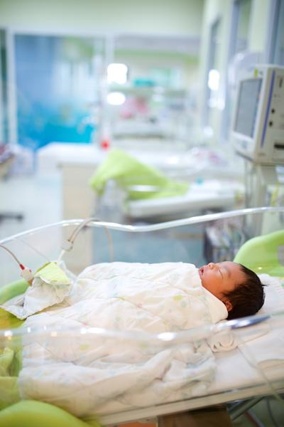
Causes of cerebral palsy
Cerebral palsy (CP) is the result of a combination of events either before, during, or after birth that can lead to an injury in a baby’s developing brain
There are multiple causes of CP – but a series of ‘causal pathways’, i.e. a sequence of events that combine to cause or accelerate injury to the developing brain.
About 45% of children diagnosed with CP are born prematurely
For most babies born at term with CP, the cause remains unknown
Only a small percentage of CP is due to complications at birth (e.g. asphyxia or lack of oxygen).

Slide 6
Risk factors
Risk factors do not cause CP. However, the presence of some risk factors may lead to an increased chance of a child being born with CP.
Some risk factors for cerebral palsy have been identified. These include:
premature birth (less than 37 weeks)
low birth weight (small for gestational age)
blood clotting problems (thrombophilia)
an inability of the placenta to provide the developing foetus with oxygen and nutrients
bacterial or viral infection of the mother, foetus or baby that directly or indirectly attacks the infant’s central nervous system
prolonged loss of oxygen during the pregnancy or birthing process, or severe jaundice shortly after birth.

Slide 7
Diagnosis
CP can sometimes now be diagnosed early, so interventions can start as soon as possible Babies can now be assessed as being at ‘high risk of cerebral palsy’ as early as 3-5 months of age.
The most sensitive tools are:
General Movements Assessment in babies <20 weeks (corrected) - 95% predictive
Neuroimaging
Hammersmith Infant Neurological Assessment (HINE) - 90% predictive
See CP: Diagnosis and Treatment poster

Slide 8
Diagnosis (cont)
Yes
Yes
Yes
Cerebral palsy
Treat early
Infant has risks for cerebral palsy?
Infant has abnormal motor development?
Infant has abnormal neuroimaging?
10-20%
Not cerebral palsy
Investigate other conditions
No
No
No

Slide 9
Diagnosis (cont)
Risks for Cerebral Palsy
Assessing Motor Development
Neuroimaging
Risk Factor | CP Risk
Maternal Risks (thyroid, pre-eclampsia, bleeds, infection, IUGR, placental abnormalities, multiples)+/-
Born Premature <28 weeks 28-31 weeks 31-37 weeks | 10.0% 5.0% 0.7%
Term Born Encephalopathy Healthy, no known risks | 12.0% 0.1%
Age: <20 weeks (corrected) | Age 6-12 months
General Movements Assessment. 95% predictive. | Developmental Assessment of Young Children (DAYC). 83% predictive.
Hammersmith Infant Neurological Assessment (HINE). Helps predict severity. | Hammersmith Infant Neurological Assessment (HINE). 90% predictive.
Abnormal Neuroimaging
Periventricular white matter injury | 19%
Cerebral malformation | 11%
CVA | 11%
Grey matter injury | 22%
Intracranial haemorrhage | 3%
Infection | 2%
Non-specific | 19%
Normal | 13%

Slide 10
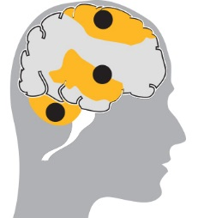
Motor types
SPASTIC: 80-90% Most common form of CP. Muscles appear stiff and tight. Arises from damage to the Motor Cortex.
DYSKINETIC: 6%
Characterised by involuntary movements such as dystonia, athetosis and/or chorea. Arises from damage to the Basal Ganglia.
ATAXIC: 5% Characterised by shaky movements. Affects balance and sense of positioning in space. Arises from damage to the Cerebellum.
MIXED TYPES:
A number of children with CP will have two motor types present, e.g. spasticity and dystonia.

Slide 11
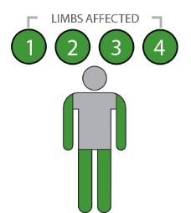
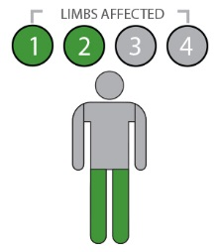
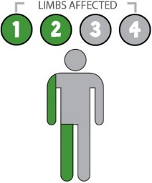
Parts of the body
Cerebral palsy can affect different parts of the body. For example, for people with spasticity:
Quadriplegia/Bilateral Spasticity
Both arms and legs are affected.
The muscles of the trunk, face and mouth are often also affected.
Diplegia/Bilateral Spasticity
Both legs are affected. The arms may be affected to a lesser extent.
Hemiplegia/Unilateral Spasticity
One side of the body (one arm and one leg) is affected.

Slide 12
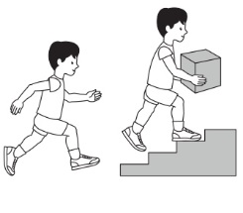
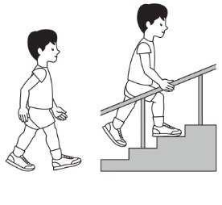
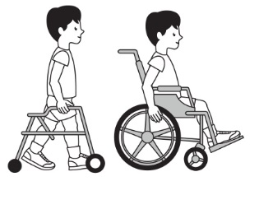
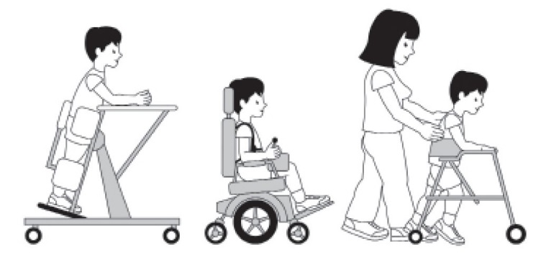
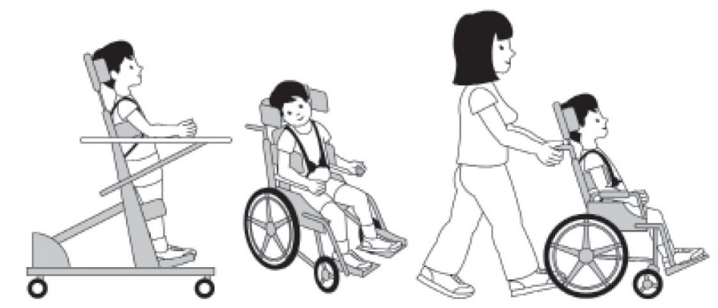
Gross motor skills
The gross motor skills of children and young people with cerebral palsy can be categorised into 5 different levels using a tool called the Gross Motor Function Classification System (GMFCS) Expanded and Revised, available from CanChild in Canada.
GMFCS Level I
GMFCS Level II
GMFCS Level III
GMFCS Illustrations 6-12: © Bill Reid, Kate Willoughby, Adrienne Harvey and Kerr Graham, The Royal Children’s Hospital Melbourne.
GMFCS Level IV
GMFCS Level V

Slide 13
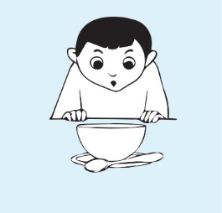
Manual ability
At least two thirds of children with cerebral palsy will have movement difficulties affecting one or both arms. Almost every daily activity can be impacted.
Eating
Dressing
Writing
Catching a ball
The ability of children from 4–18 years old with cerebral palsy to handle objects in everyday activities can be categorised into 5 levels using the Manual Ability Classification System (MACS). More details at www.macs.nu/index.php

Slide 14
Associated impairments
Children with CP may also have a range of physical and cognitive impairments
1 in 3 is unable to walk | 1 in 4 is unable to talk | 3 in 4 experience pain | 1 in 4 has epilepsy | 1 in 4 has a behaviour problem
1 in 2 has an intellectual disability | 1 in 10 has a severe vision impairment | 1 in 4 has bladder control problems | 1 in 5 has a sleep disorder | 1 in 5 has saliva control problems

Slide 15
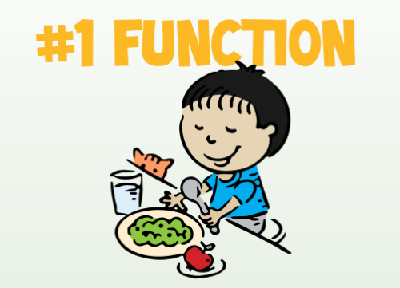
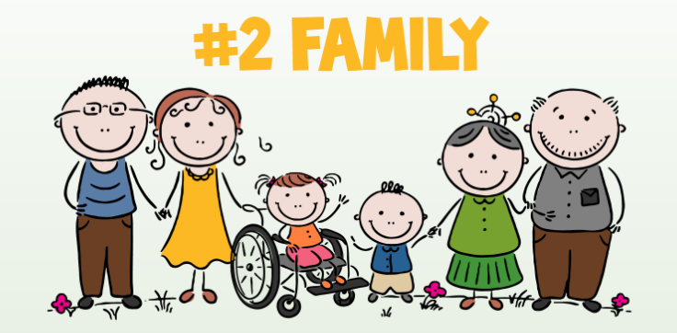
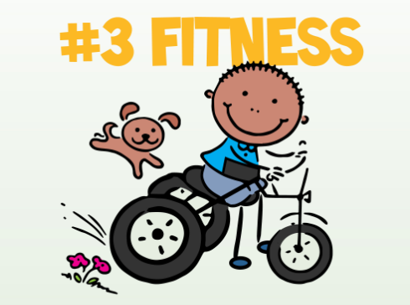
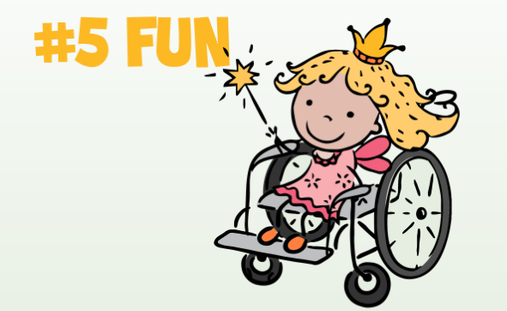
Focus for child development
The 'F-words' focus on six key areas of child development that are vital to all children with CP.
More details at https://www.canchild.ca/en/research-in-practice/f-words-in-childhood-disability

Slide 16
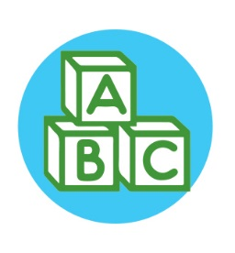
Treatment considerations
 | PAIN
 | 3 in 4: Treat to prevent sleep and behavioural disorders
 | HIP DISPLACEMENT
 | 1 in 3: 6-12 months hip surveillance using x-ray
 | INTELLECTUAL DISABILITY
 | 1 in 2: Poorer prognosis for ambulation, continence, academics
 | NON-VERBAL
 | 1 in 4: Augment speech early
 | NON-AMBULANT
 | 1 in 4: Independent sitting at 2 years predicts ambulation
 | EPILEPSY
 | 1 in 4: Seizures will resolve for 10-20% of children

Slide 17
Treatment considerations (cont.)
 | BEHAVIOUR DISORDER
 | 1 in 4: Treat early and ensure that pain is managed
 | BLINDNESS
 | 1 in 10: Assess early and accommodate
 | BLADDER INCONTINENCE
 | 1 in 4: Conduct investigations and allow more time
 | NON-ORAL FEEDING
 | 1 in 15: Assess swallow safety and monitor growth
 | SLEEP DISORDER
 | 1 in 5: Conduct investigations and ensure pain is managed
 | DEAFNESS
 | 1 in 25: Assess early and accommodate

Slide 18
Future
With the support of parents, families, communities, governments and health professionals, children with cerebral palsy will lead healthy and contributing lives
The future is bright, with international efforts to collaborate in research, practice, education, technology and social action by, and for, people with CP
Join World Cerebral Palsy Day and become part of this global community to improve the lives of people with CP around the world.
WORLD CEREBRAL PALSY DAY ON OCTOBER 6

Slide 19
References
Australian Cerebral Palsy Register Report 2013 www.cpregister.com
Eliasson, A.-C., Krumlinde-Sundholm, L., Rösblad, B., Beckung, E., Arner, M., Öhrvall, A.-M., & Rosenbaum, P. (2007). The manual ability classification system (MACS) for children with cerebral palsy: Scale development and evidence of validity and reliability. Developmental Medicine & Child Neurology, 48(7), 549–554. doi:10.1111/j.1469-8749.2006.tb01313.x
Novak, I. (2014). Evidence-based diagnosis, health care, and rehabilitation for children with cerebral palsy. Journal of Child Neurology, 29(8), 1141–1156. doi:10.1177/0883073814535503
Novak, I., Hines, M., Goldsmith, S., & Barclay, R. (2012). Clinical Prognostic messages from a systematic review on cerebral palsy. PEDIATRICS, 130(5), e1285–e1312. doi:10.1542/peds.2012-0924
McIntyre, S., Morgan, C., Walker, K., & Novak, I. (2011). Cerebral palsy-don’t delay. Developmental Disabilities Research Reviews, 17(2), 114–129. doi:10.1002/ddrr.1106
Palisano, R., Rosenbaum, P., Walter, S., Russell, D., Wood, E., & Galuppi, B. (2008). Development and reliability of a system to classify gross motor function in children with cerebral palsy. Developmental Medicine & Child Neurology, 39(4), 214–223. doi:10.1111/j.1469-8749.1997.tb07414.x www.canchild.ca.
Report of the Australian Cerebral Palsy Register, Birth Years 1993-2009, September 2016.

